Slide 1
SIMPLE QUEUE SERVICE

Slide 2
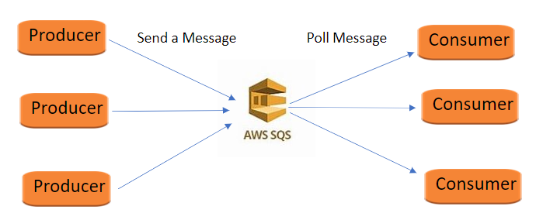
SQS : Simple Queue Service
Producing Message :
Produced to SQS using SDK (SendMessage API)
Message is persisted in SQS until a consumer deletes it
Message retention : Default 4 days , Change into 1 Minutes -- Up to 14 days
Consuming Message :
Consumers (Running on EC2 instances, servers, Lambda, ...)
Poll SQS for messages (receive up to 10 msg at a time )
Delete the messages

Slide 3
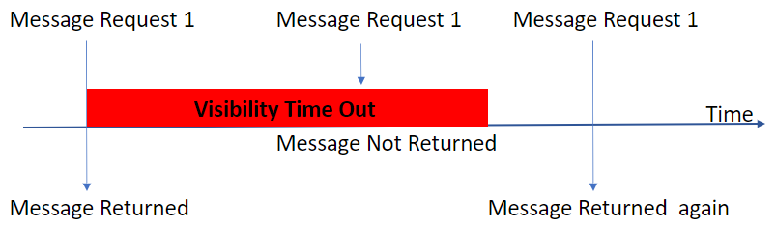
Message Visibility Timeout
If the Message is not processed with in visibility timeout , it will appear again
If visibility timeout is high --> Reprocessing will take time
If visibility timeout is low --> May get duplications

Slide 4
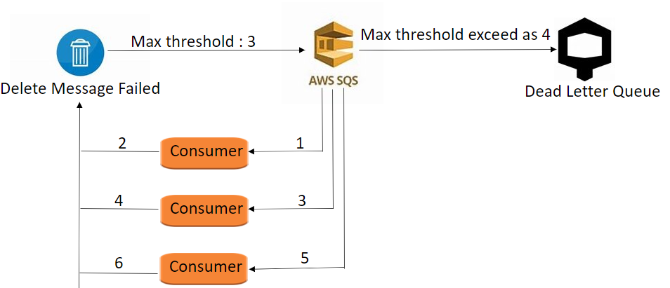
DLQ – Dead Letter Queue
If a consumer fails to process a message within a timeout....the message goes back to the queue
Set a threshold – How many times -- message go back to the queue
After the MaximumReceives threshold is exceeded – message goes into a DLQ
Useful for debugging
Make sure to process the messages in the DLQ before they expire,
--> Good to set a retention of 14 days in the DLQ

Slide 5
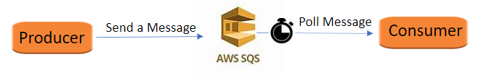
Delay Queue
Delay a message up to 15 minutes – Consumers don't see it immediately
Default – 0 second
Can change the default using DelaySeconds parameter

Slide 6
SIMPLE NOTIFICATION SERVICE

Slide 7
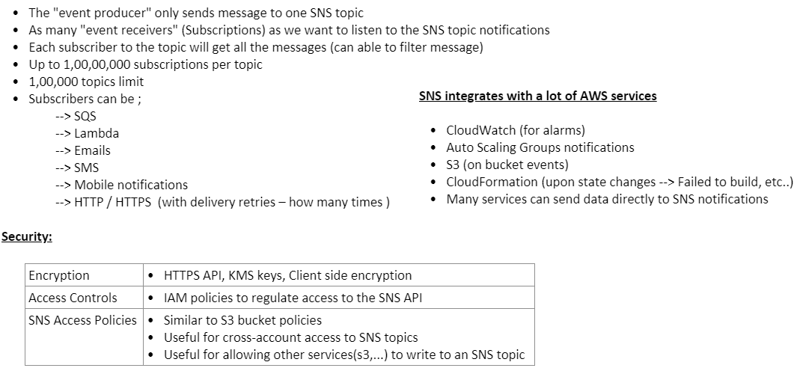
SNS - Simple Notification Service

Slide 8
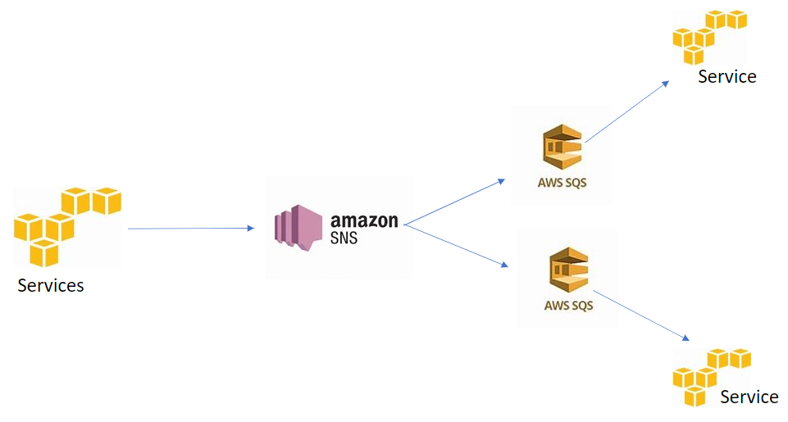
SNS + SQS : Fan Out
Push once in SNS, receives in all SQS queue that are subscribers
No data loss
Ability to add more SQS subscribers over time
Make sure your SQS queue access policy allows for SNS to write

Slide 9
Queue Access Policy

Slide 10
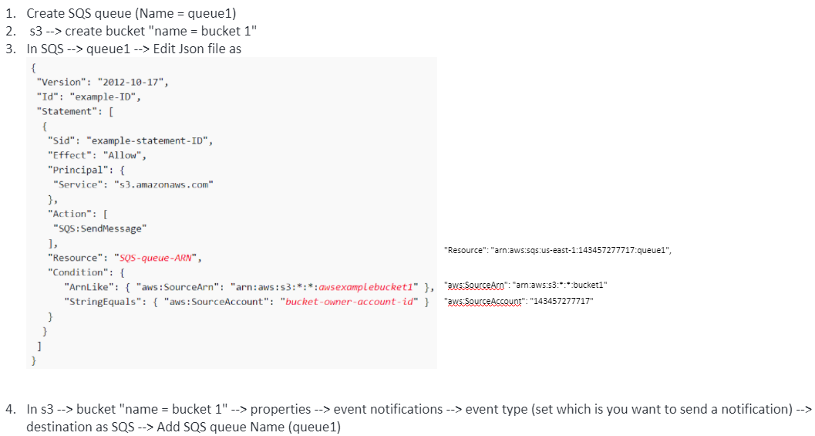
Publish S3 Event Notifications to SQS Queue:

Slide 11
Setup SNS notification to SQS :
SQS --> Create a queue (name = ForSNS)
SNS --> Create topic (name = MyTopic-1)
--> Subscription --> protocol (SQS) --> endpoint (ForSNS) --> Create
SQS --> ForSNS --> SNS Subscriptions --> add topic (MyTopic-1)
<< Set S3 event configuration for SNS , then SNS send a notification to SQS >>
5. S3 --> create bucket "name = s3--sns--test"
6. SNS --> topics --> MyTpoic-1 --> Edit --> Access policy
{
"Version": "2012-10-17",
"Id": "example-ID",
"Statement": [
{
"Sid": "example-statement-ID",
"Effect": "Allow",
"Principal": {
"Service": "s3.amazonaws.com"
},
"Action": "SNS:Publish",
"Resource": "arn:aws:sns:us-east-1:143457277717:MyTopic-1",
"Condition": {
"StringEquals": {
"aws:SourceAccount": "143457277717"
},
"ArnLike": {
"aws:SourceArn": "arn:aws:s3:*:*:s3--sns--test"
}
}
}
]
}
7. In s3 --> bucket "name = s3--sns--tes" --> properties --> event notifications --> event type (set which is you want to send a notification) --> destination as SNS --> Add SNS Topic Name (MyTopic-1)

Slide 12
Lambda trigger SNS :
Lambda --> Create a function (Name = ForSQS)
IAM --> Roles --> Create roles --> Lambda --> AWSLambdaSQSQueueExecutionRole
Lambda --> ForSQS --> configuration --> permission --> execution role --> edit --> add the above role
SQS --> Create a queue (name = ForLambda)
SQS --> ForLambda --> Lambda triggers --> select Lambda function (ForSQS)

